Slide 1
Mass transport modelling with
GRACE and GRACE-FO
Frank Flechtner
Helmholtz Centre Potsdam, GFZ German Research Centre for Geosciences, Potsdam
Section 1.2 „Global Geomonitoring and Gravity Field“
Webinar, 13.08.2019

Slide 2
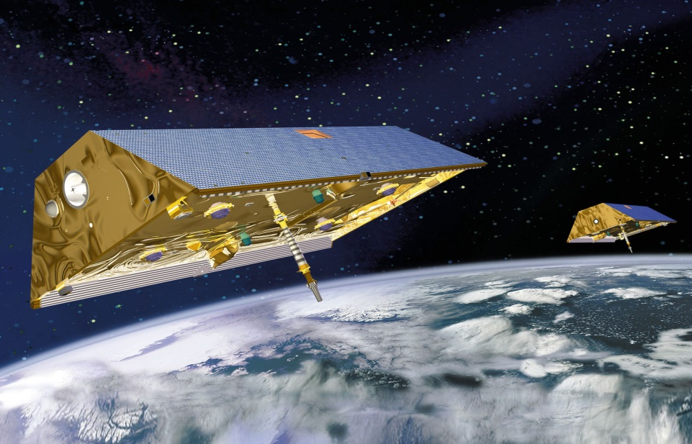
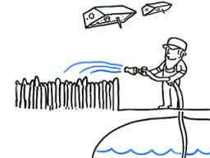
Mass Transport Monitoring from Space
GRACE = Gravity Recovery and Climate Experiment
The twin satellites and their relative motion in space are the experiment!
GRACE and it´s successor GRACE Follow-on (GRACE-FO) are the only missions to monitor mass transport in system Earth
Mass transport is related to climate change related issues such as variations in the global water cycle (ground water depletion, droughts, flooding), ice melting in large glacier systems or sea level rise.

Slide 3

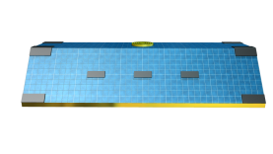

Measurement Principle (1)
Gravitational Law: where 1=Earth, 2=Satellite
Courtesy: D. Schütze (AEI Hannover)

Slide 4
Measurement Principle (2)
Courtesy: D. Schütze (AEI Hannover)

Slide 5
Measurement Principle (3)
Courtesy: D. Schütze (AEI Hannover)

Slide 6
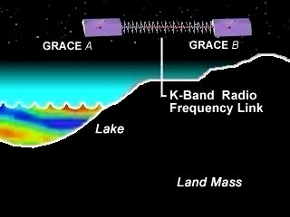
Measurement Principle and KBR Accuracy
Distance: ca. 220,000000000 km
Accuracy: 1μm = 12 digits

Slide 7
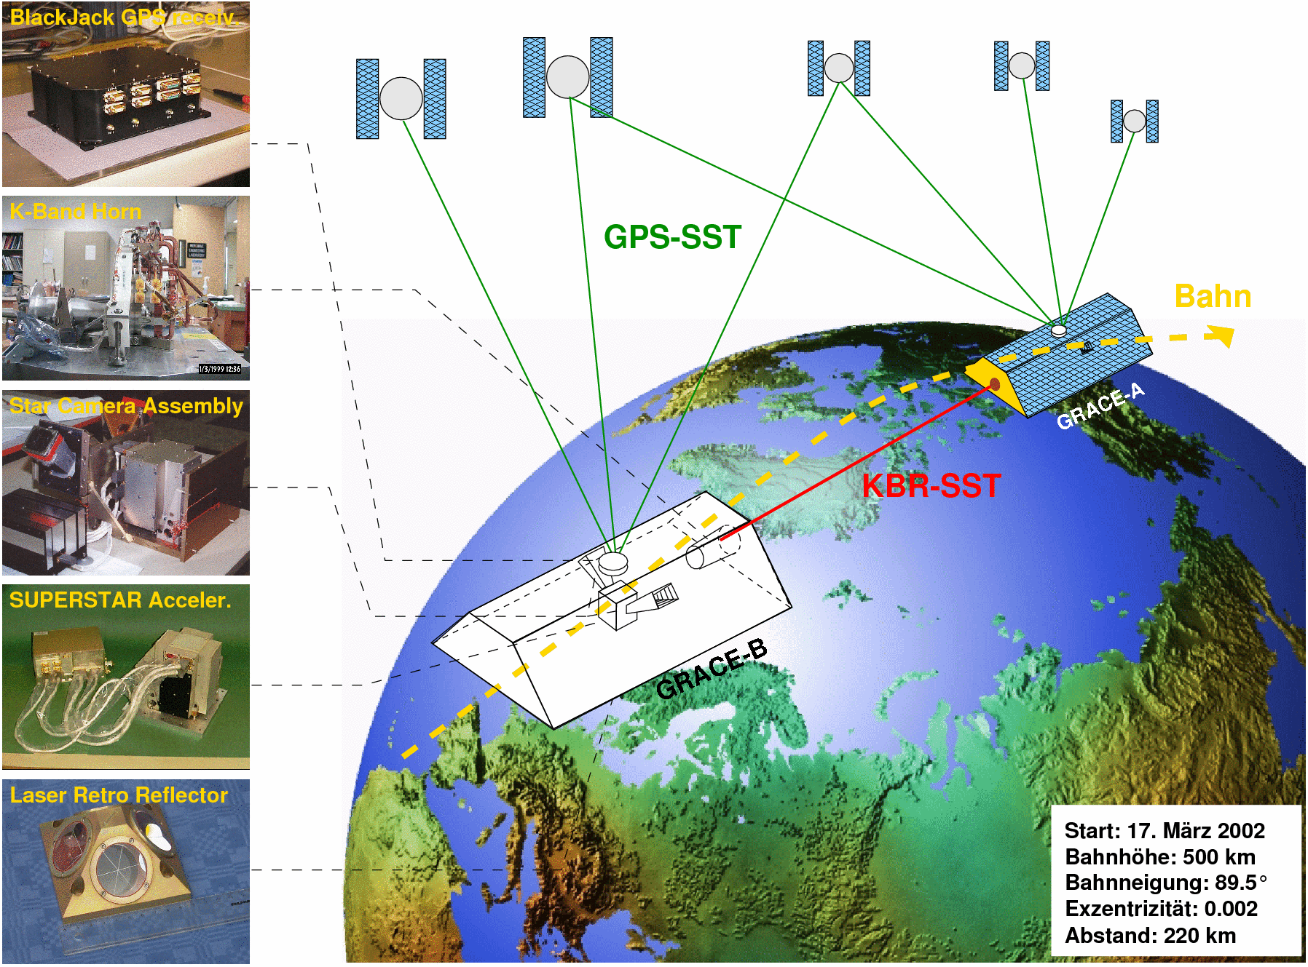
GRACE Instruments and Observations
Observation of gravitationally caused orbit perturbations along the common line of sight of a twin satellite pair by
high-low (GPS) and
low-low (K-Band) Satellite-to-Satellite Tracking (SST)
Observation of non-gravitational accelerations by 3D Accelerometer
Observation of the satellite and instrument orientation by Star Cameras
Validation of GPS-derived orbit by Satellite Laser Ranging (SLR)

Slide 8
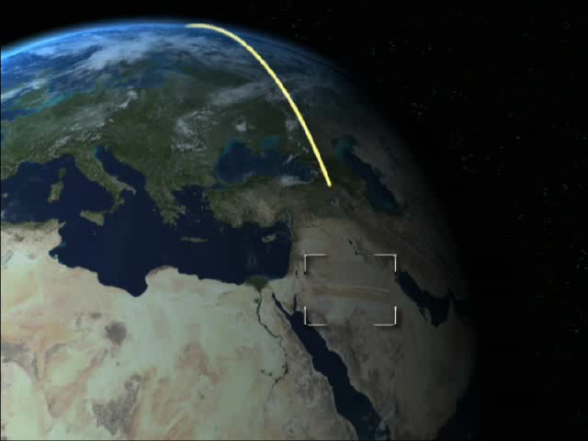
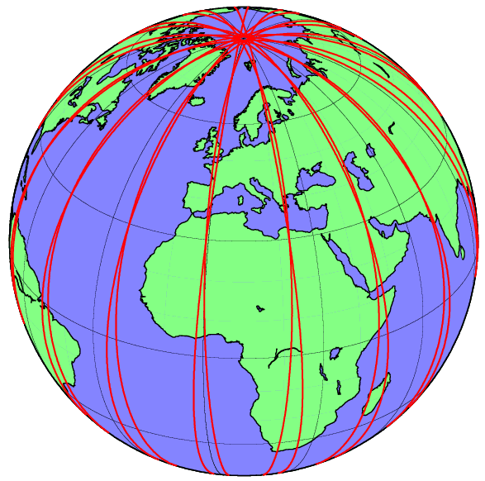
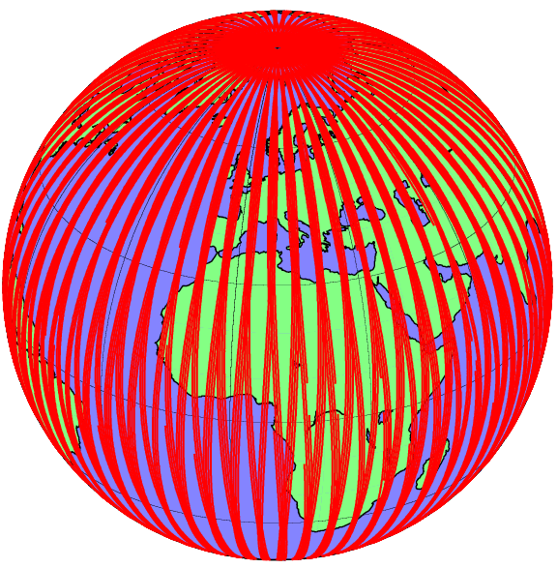
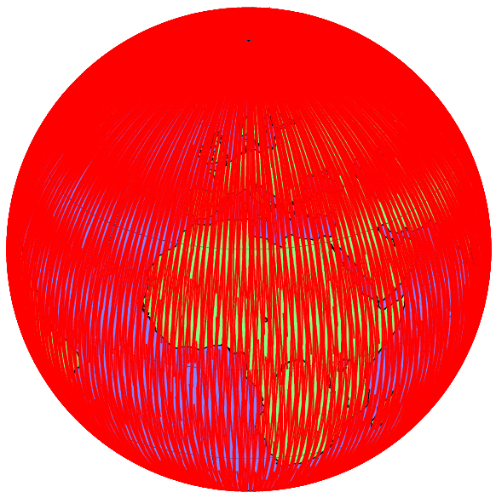
Coarse Principle of Gravity Field Determination (1)
1 day
15 days
30 days
Unknown parameters, incl. spherical harmonic coefficients, are obtained e.g. by dynamical orbit determination and least squares adjustment.
Observations are the geometric difference of the (observed) real orbit from a (theoretical, computed) reference orbit = o-c

Slide 9

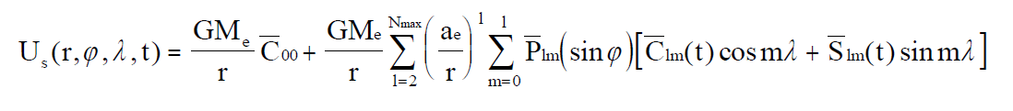
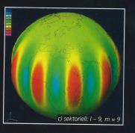
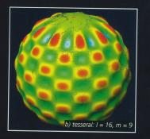
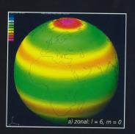
Coarse Principle of Gravity Field Determination (2)
To derive the global gravity field of the Earth the satellite orbit is numerically integrated in an
inertial reference system
For this we need
  Approximate initial position and velocity of the satellite
  Disturbing (gravitational, non-gravitational, empirical) forces acting on the satellites
By variation of the initial values of position and velocity we get an orbit which is best adjusted to the satellite orbit observations (o-c).
From the remaining observation residuals o-c of the adjustment process we get the gravitational potential U represented by (time dependent) spherical harmonic coefficients Clm(t)/Slm(t)
zonal
Sectorial
l=9
m=9
Tesseral
l=16
m=9
Zonal
l=6
m=0

Slide 10
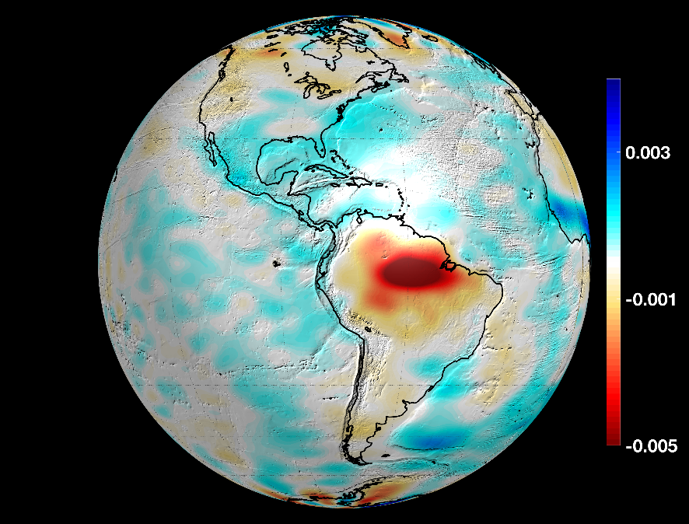
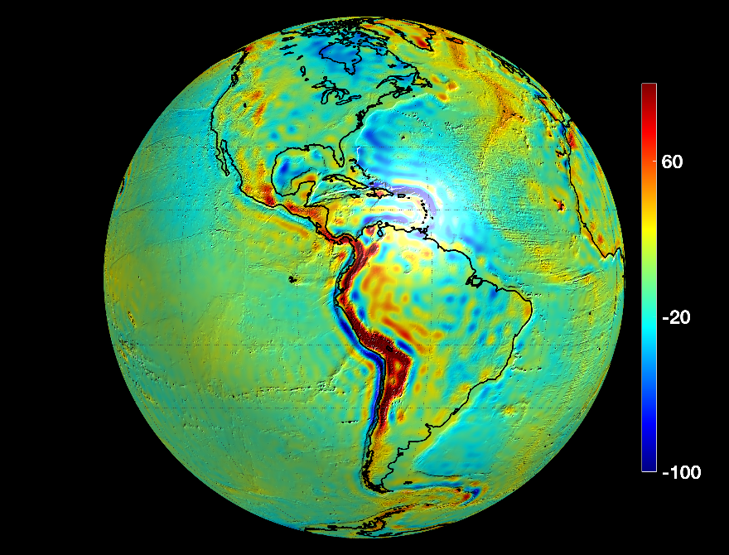

Time Variations of the Gravity Field
Change: Aug to Sep 2006 (Factor ~1:10.000)
1mGal =10⁻⁵ m/s²
100
0
-100
100
0
-100
August 2006
September 2006

Slide 11
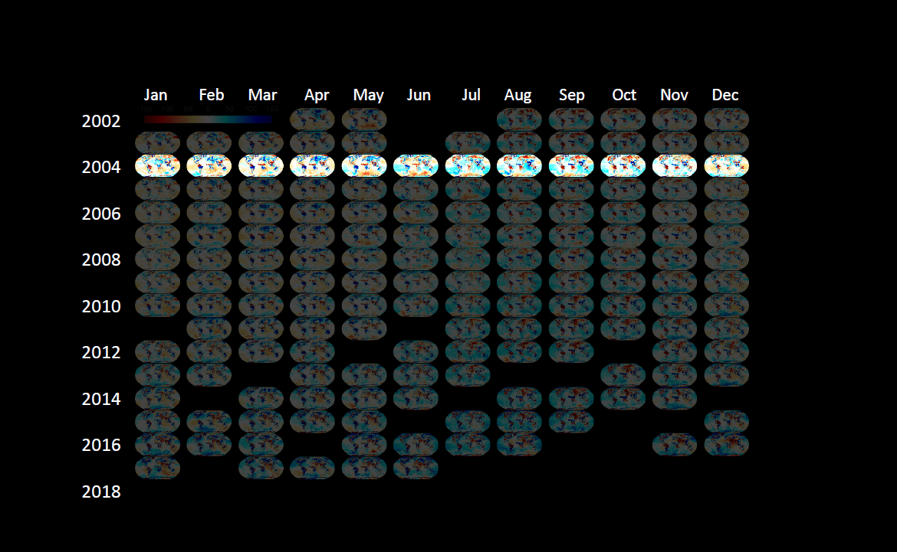
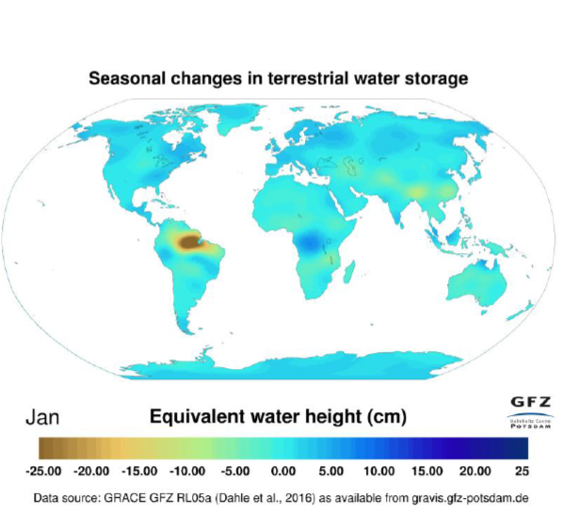
GRACE: 15 Years of Amazing Discoveries
2018

Slide 12
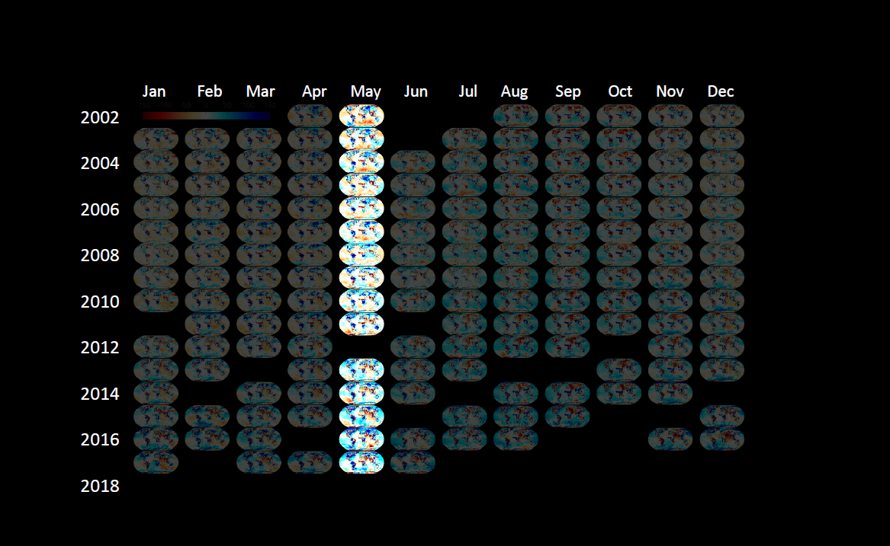
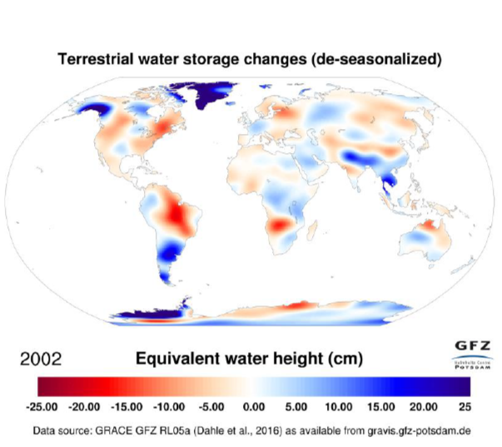
GRACE: 15 Years of Amazing Discoveries

Slide 13
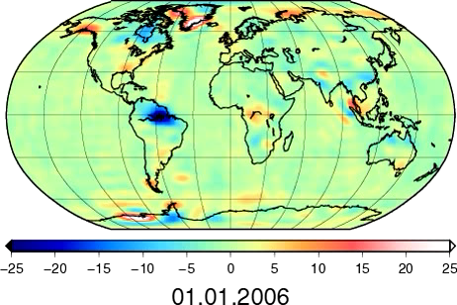
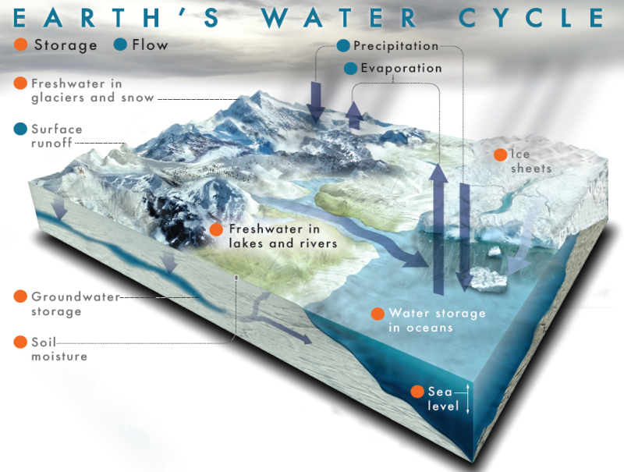
GRACE and Hydrology
Monitoring of Continental Hydrological Cycle
Close the global Water Balance
[cm EWH]
Courtesy: IGG Bonn
ΔTWS(t) = Total Water Storage
ΔGW(t) = Ground Water
ΔSW(t) = Surface Water
ΔSWE(t) = Snow Water Equivalent
ΔSM(t) = Soil Moisture
ΔRO(t) = Run Off
ΔTWS(t) = ΔGW(t) + ΔSW(t) + ΔSWE(t) + ΔSM(t) - ΔRO(t)
}
can only be provided by GRACE!
From archives, e.g.
SM from NASA Global Land Data Assimilation System
SWE from NOAA Snow Data Assimilation System
or satellites, e.g.
SMOS, SMAP
} ΔAW(t) = Accessible Water

Slide 14
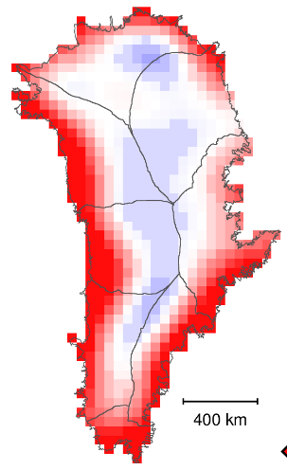
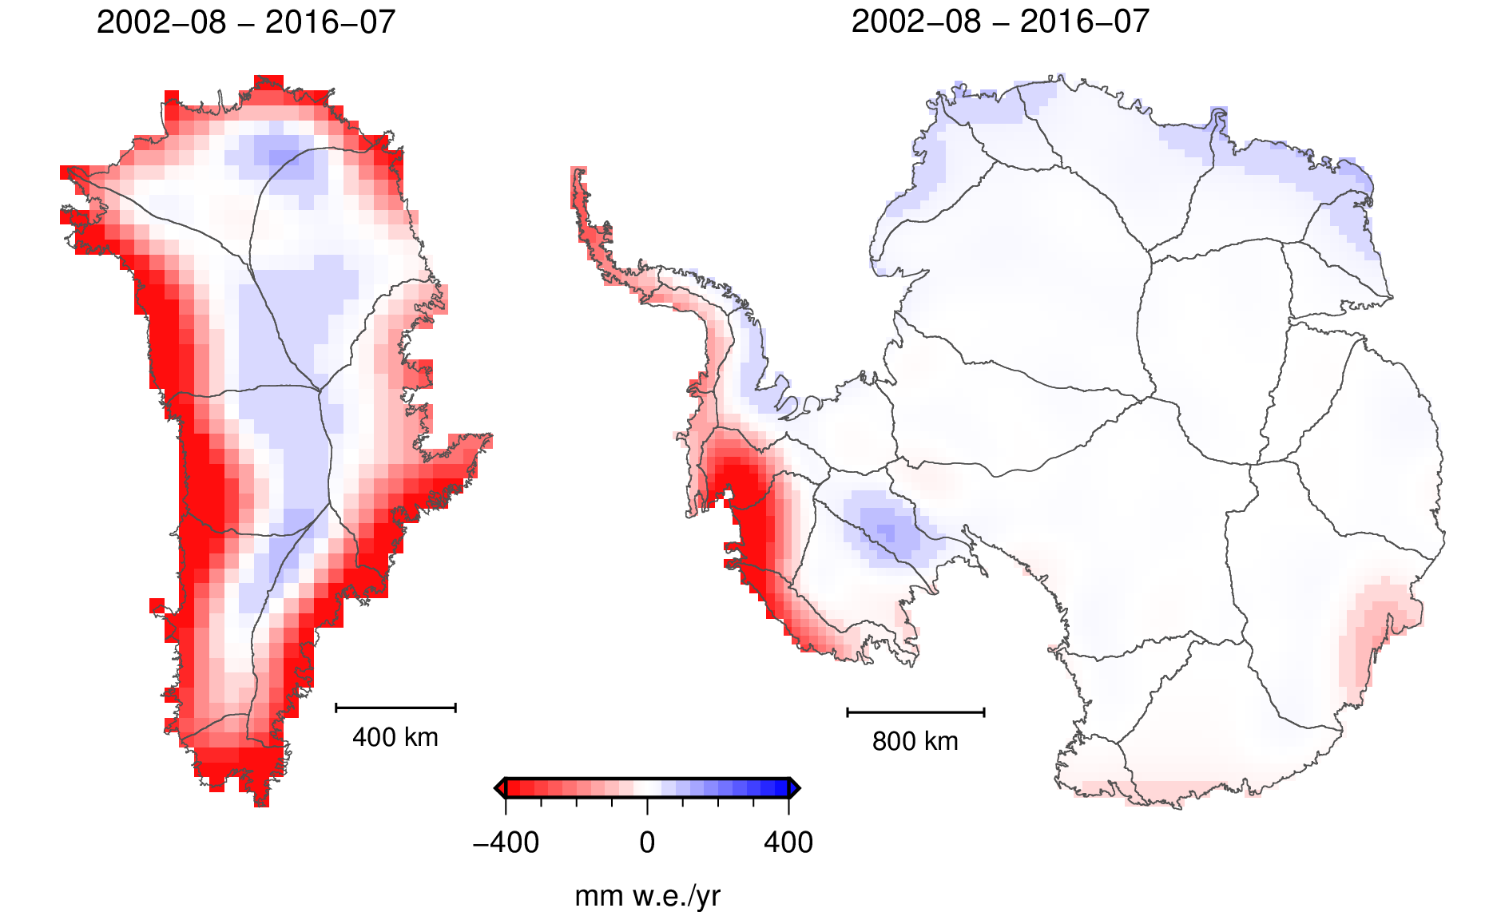
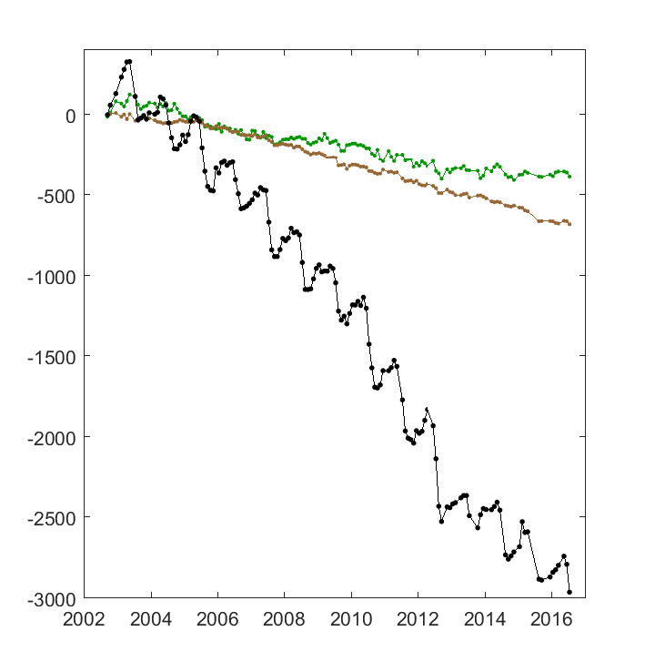
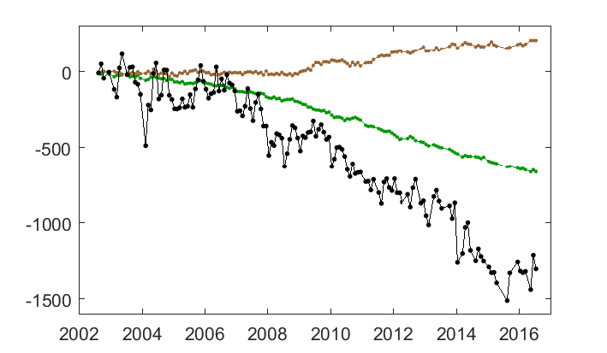
Greenland vs. Antarctica
6
Mean rate of change
(08/2002–07/2016)
8
4
[mm w.e./yr]
4
22
8
Mass [Gt]
6
Entire Greenland
22
Mass [Gt]
Entire Antarctica
Source: CCI Greenland, CCI Antarctica Gravimetry Mass Balance Products, data1.geo.tu-dresden.de

Slide 15
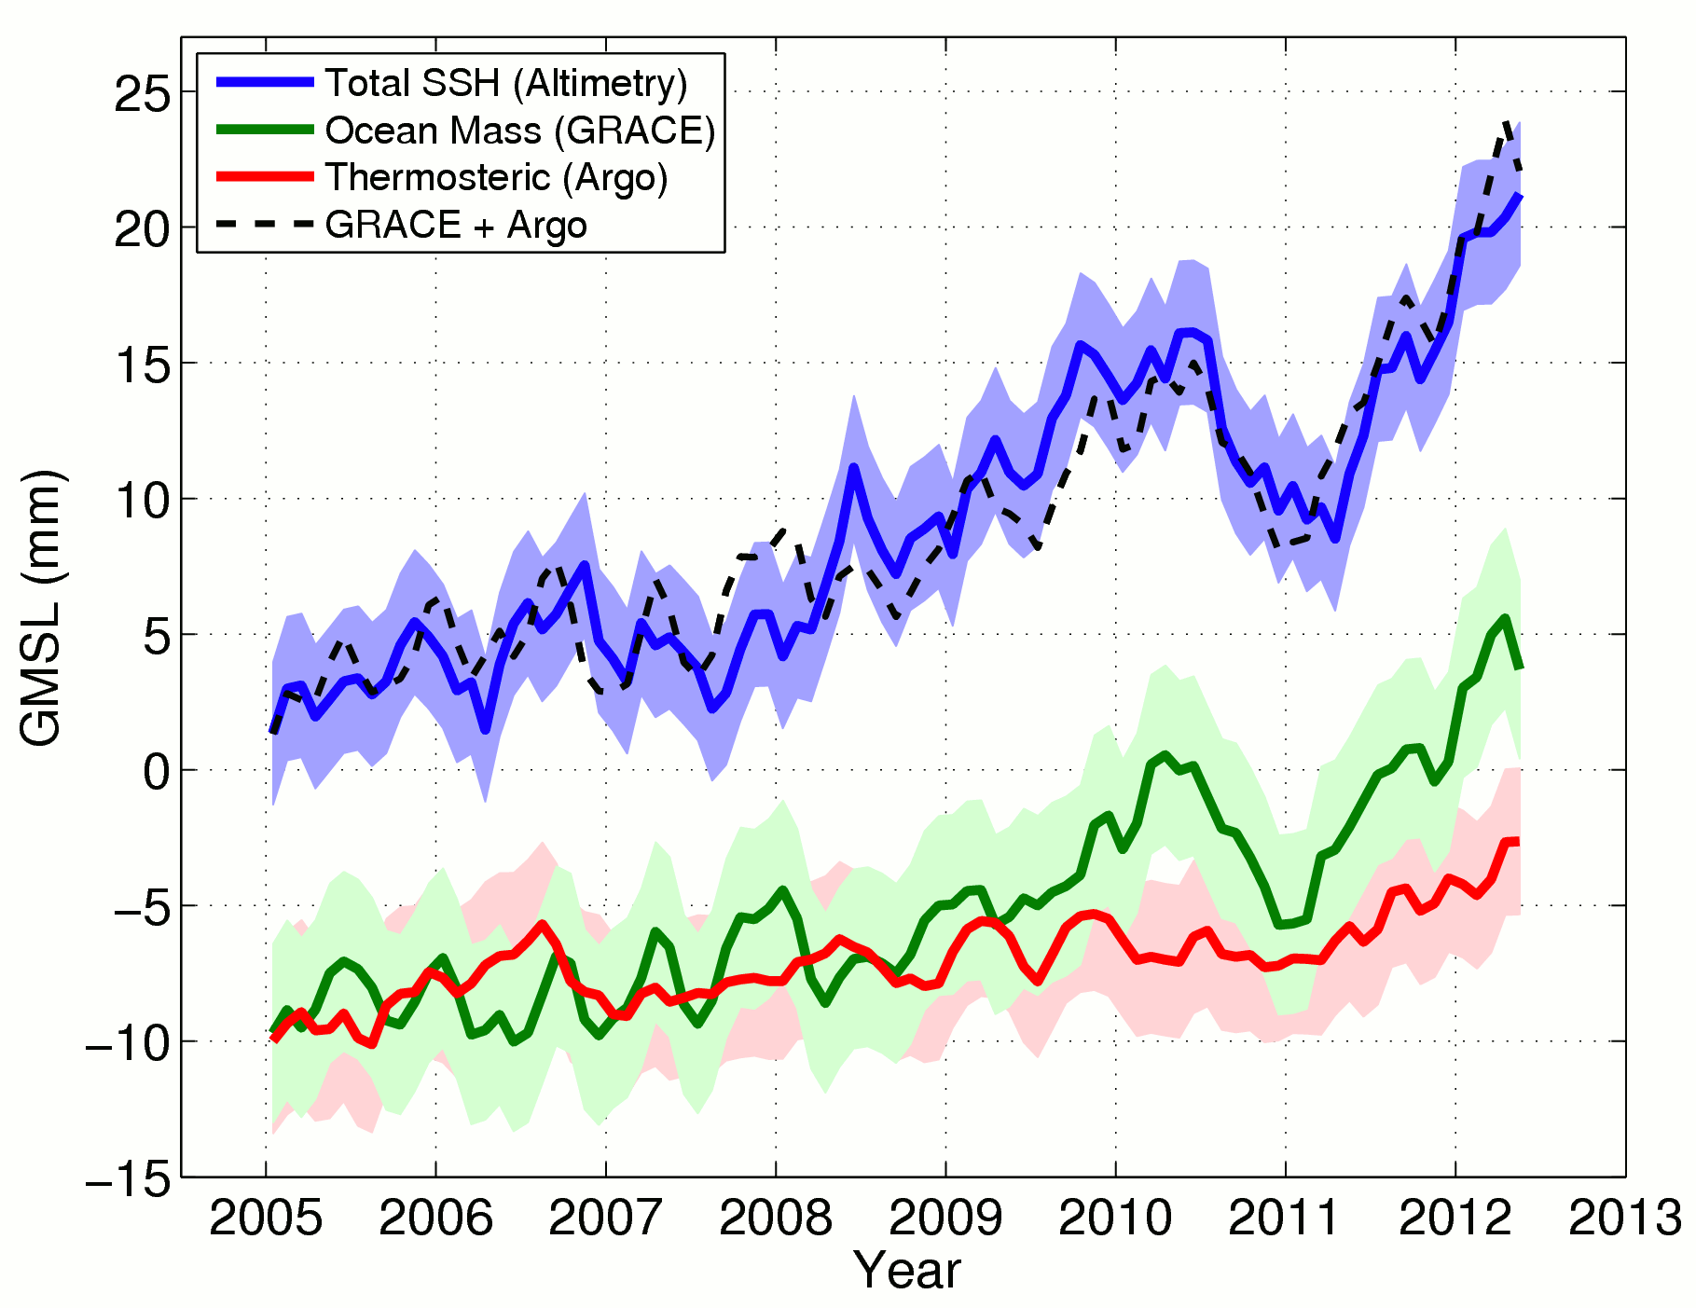

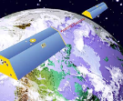
GRACE and Altimetry for Sea Level Rise Monitoring

Slide 16

GRACE-FO
NASA and GFZ responded to science community call for a continuation mission (GRACE Follow-On).
Initial discussions in 2009/2010
Funding in Germany secured 2012
GRACE-FO launched on May 22, 2018.

Slide 17
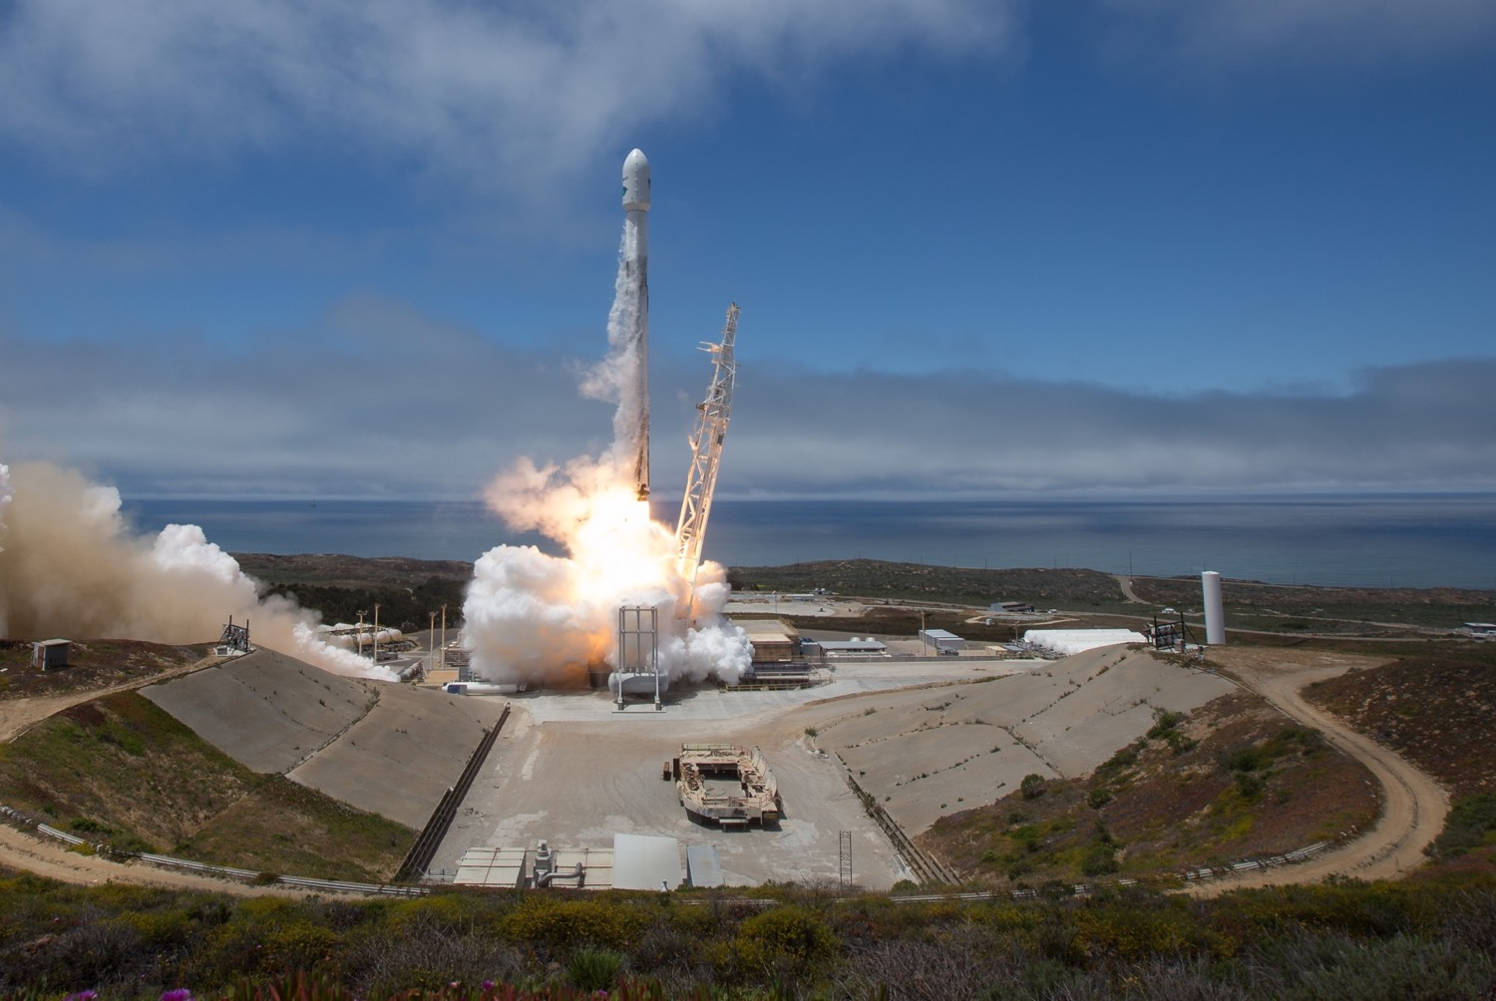
GRACE-FO in a Nutshell
Nominal GRACE-FO Launch:
May 22, 2018
Launch-Early Orbit Phase (LEOP):
May-22 – May-26, 2018
In-Orbit-Checkout (IOC):
May-27, 2018 – Jan-27, 2019
First Science Data:
May 30, 2018
Start of Science Phase ( E ):
Jan 28, 2019
First Level-1 Data Delivery:
May 28, 2019
First Level-2 Data Delivery:
Jul 26, 2019

Slide 18
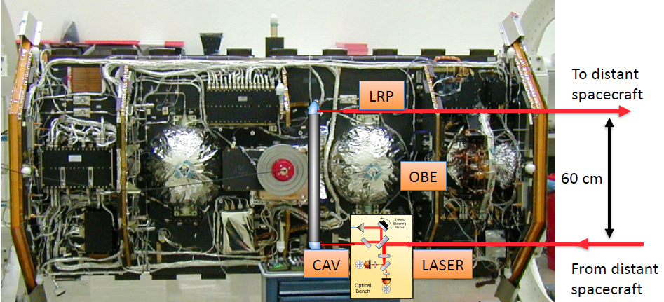
GRACE-FO Laser Ranging Interferometer (Tech Demo)

Slide 19
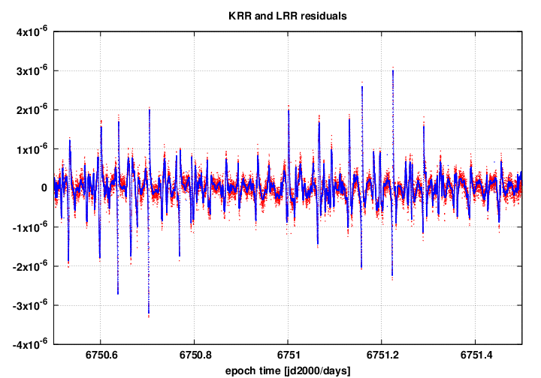
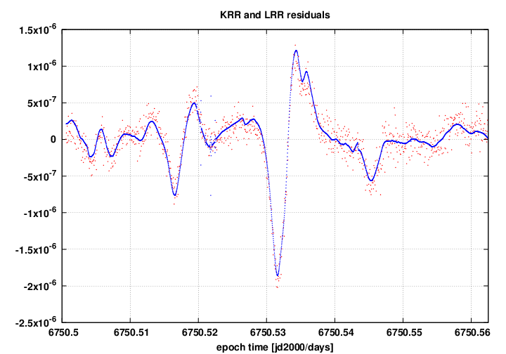
GRACE-FO LRI Data (Example GFZ Processing)
26 June 0-24h
26 June 0-1.5h

Slide 20
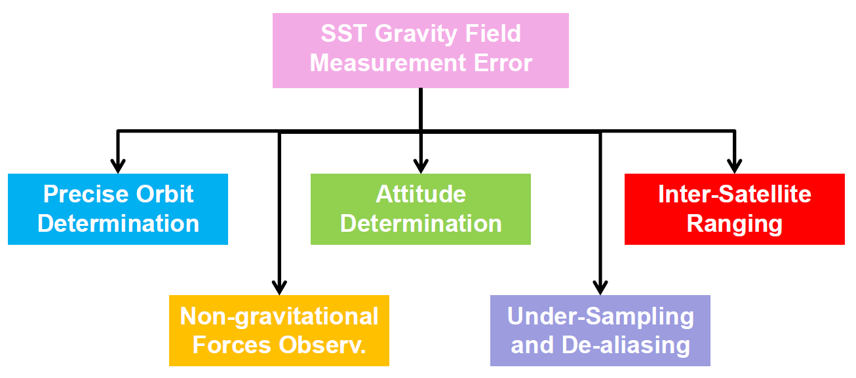
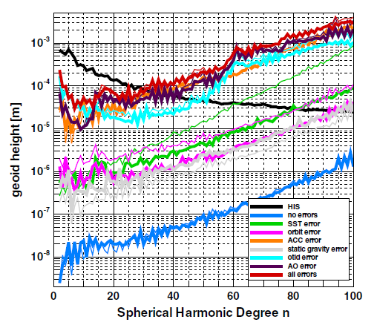
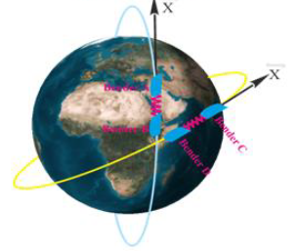
What can be expected from the GRACE-FO LRI?
Flechtner et al. (2016): What Can be Expected from the GRACE-FO Laser Ranging Interferometer, Surv. in Geoph.

